Slide 1

Vacation 4 u by group 4

Slide 2
Introduction
In recent years, the world of tourism has experienced an increase in demand, in parallel with the advancement of technology.
Vacation4u is software that answer the needs of the customer and the user in this age.
Software that combines the most innovative technology with the customer's needs, provides the customer with relief from the hassle involved in organizing a trip to an extent that usually requires a logistical complex that is not in the hands of a reasonable person.
While maintaining human service.

Slide 3







Meet the team
Shira avital Mahgerefte , 22 , from Ashdod
Team Leader
Elie bracha , 25 , from Paris.
Code developer & Documents designer
Neriya Zudi , 24 , from Yavne
Code developer & Requirements Manager
Lihi Sabag , 24 , from Ashdod
Code developer & Documents designer
Idan Fadlon ,24 , from Ashqelon
Code Developer & tester
Sergey Pechyoni , 24 , from Ashdod
Code Developer & tester

Slide 4
Main Requirements
The travel agent will be able to add/delete a package from the DB.
The travel agent be able to track orders that made by the customers.
The agency customers will be able to search package by many categories such as package dates/departure date/destination etc.
The agency customers will be able to contact an agent.
The agency customers will be able to make a reservation of hotels , flight or vacation .
Every reservation will have one of three optional statuses.
The travel agent will be able to change the reservation status.
Manager already exist in the system

Slide 5



Project content
Vacation 4 U Is a system for ordering packages in the most efficient way , Our project includes connecting to the system for the three personalities - manager, agent and customer.
Manager
Access to system data.
Adding agents.
Tracking company data (earnings and sales).
Agent
Packages - add / delete and update.
Personal response to each customer.
Order confirmation / cancellation.
The agents are divided into area.
Customer
Option to search and order a custom package.
Can contact an agent.
Change details
Delete account

Slide 6
Exclusive features
The agent can add different packages and the customer can search for different packages according to the filters he chooses.
The system offers a vacation friend service , that connected between customers that booked the same vacation, and Organized trips for groups.
In addition, the system includes a special interface for the manager where he can track the company’s profits, and can add agents.
When paying and making a reservation, it is possible to pay at points that the customer has and when ordering a package (flight + hotel) the customer will be added points.

Slide 7
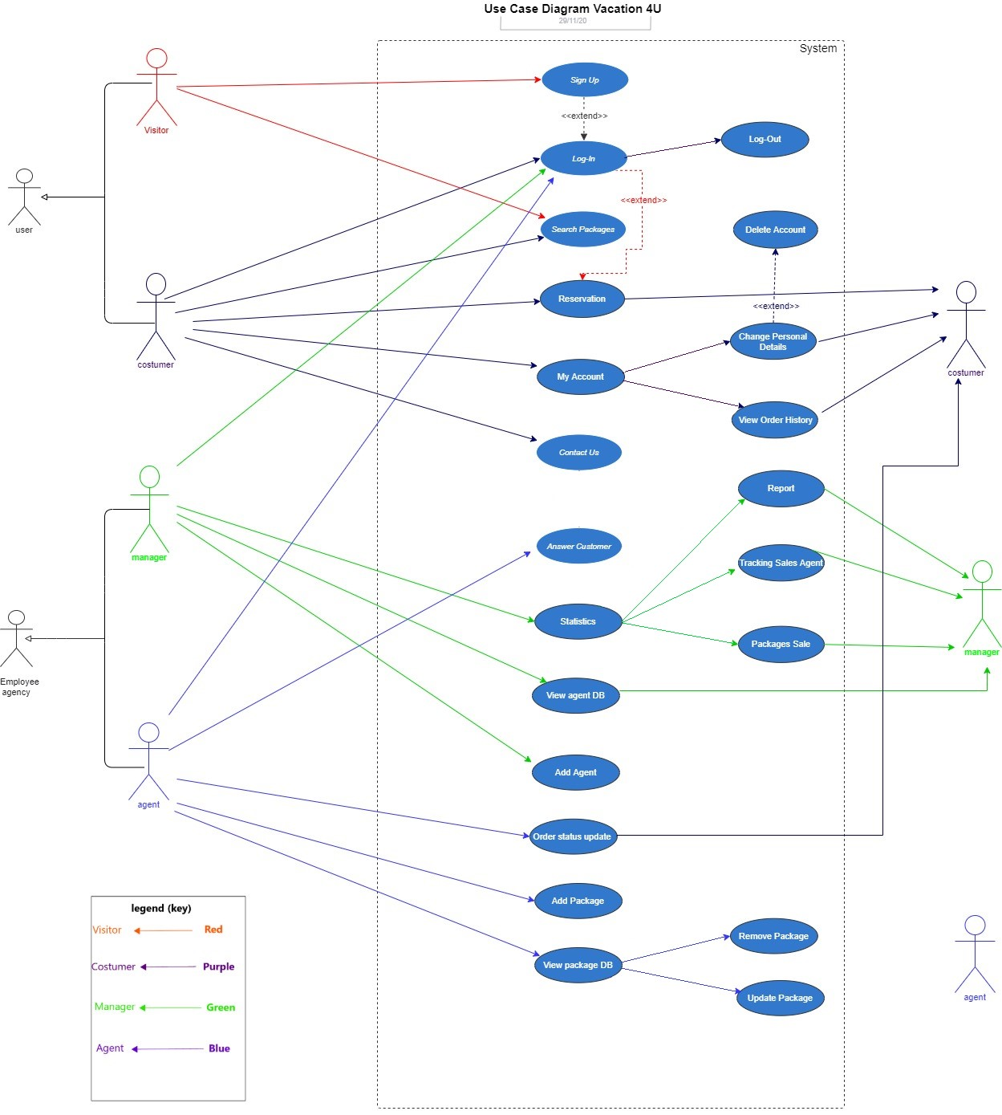
Use case

Slide 8
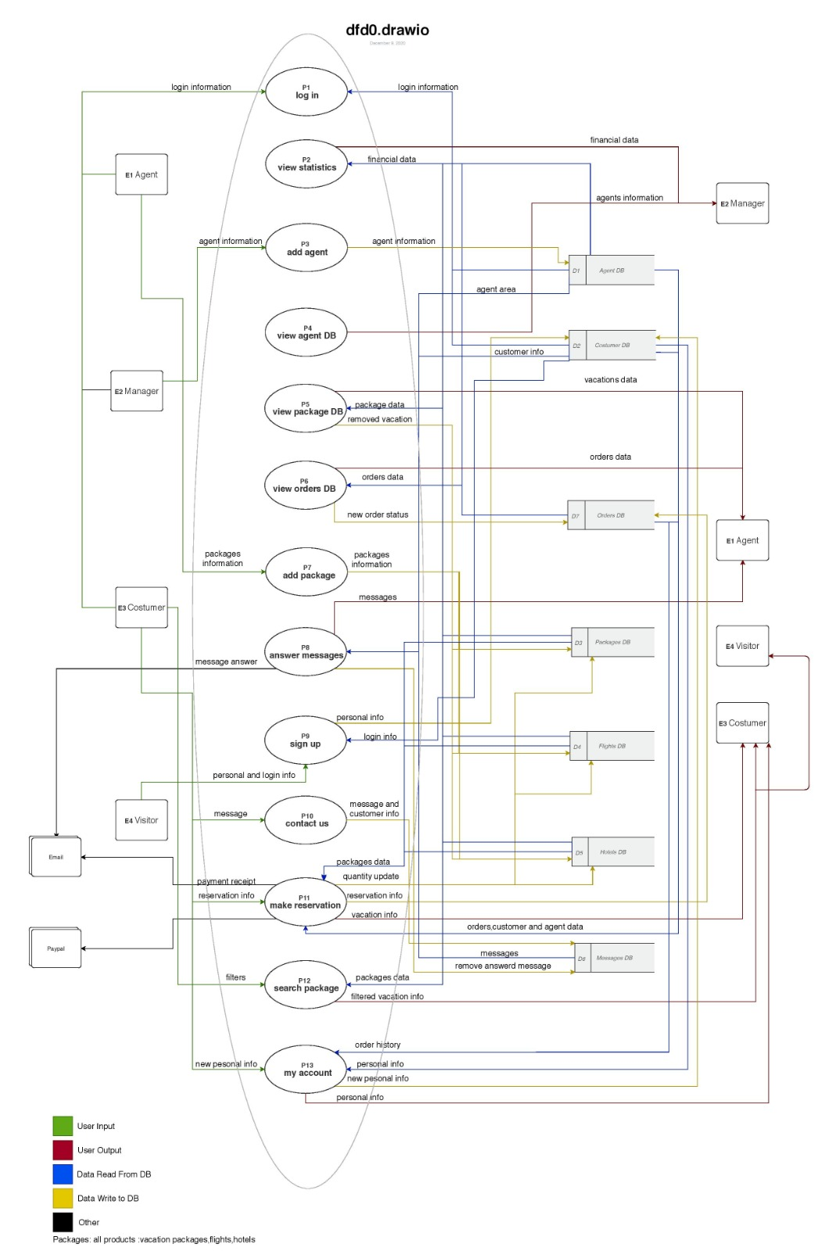
DFD 0

Slide 9
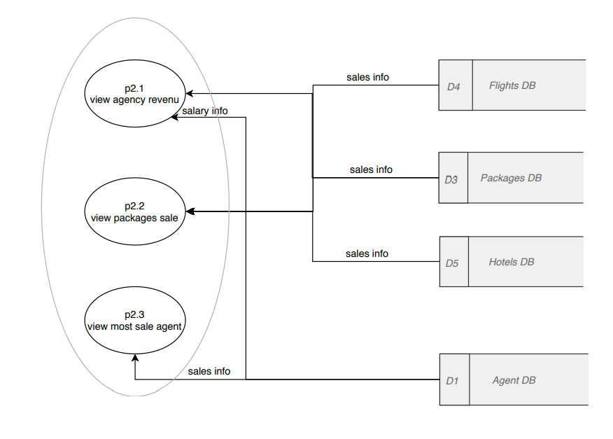
DFD 1 Manager

Slide 10
Testing
In the final part of the project, we performed extensive tests on the system, such as regression tests, functionality tests, etc.
The work during the project was according to the "waterfall" model therefore this part is done separately.
The tests were performed manually by the team members according to the test case format
At the end of the process we verified the integrity of the system against the customer's requirement.
If a test failed, the code was corrected accordingly and regression tests were performed.

Slide 11
We tested the ability of an agent to update the number of travelers field on a package:
Step | Test Steps | Test Data | Expected Result | Actual Result | Status (Pass/Fail) | Notes
1 | Navigate to View Package DB | Press 4 | View Package DB page shows up | View Package DB page shows up | Pass
2 | Navigate to View all existing DB | Press 1 | All the packages in the DBs are displayed | All the packages in the DBs are displayed | Pass
3 | Navigate to update menu | Press 2 | Update menu displayed | Update l menu displayed | Pass
4 | Navigate to package update | Press 1 | package l choice message displayed | package choice message displayed | Pass
5 | Choose a package | Press P1 | Field to update menu displayed | Field to update menu displayed | Pass
6 | Choose to change number of travelers | Press 7 | New number of travelers choice message displayed | New number of travelers choice message displayed | Pass
7 | Enter new number of travelers | number of travelers: 5 | number of travelers changed to 5 | number of travelers changed to 5 | Fail | Unwanted changes in database
8 | Log out | Follow instructions on screen to log out | User logged out | User logged out | Pass

Slide 12
We tested again after fixing the code:
Step | Test Steps | Test Data | Expected Result | Actual Result | Status (Pass/Fail) | Notes
1 | Navigate to View Package DB | Press 4 | View Package DB page shows up | View Package DB page shows up | Pass
2 | Navigate to View all existing DB | Press 1 | All the packages in the DBs are displayed | All the packages in the DBs are displayed | Pass
3 | Navigate to update menu | Press 2 | Update menu displayed | Update l menu displayed | Pass
4 | Navigate to package update | Press 1 | package l choice message displayed | package choice message displayed | Pass
5 | Choose a package | Press P1 | Field to update menu displayed | Field to update menu displayed | Pass
6 | Choose to change number of travelers | Press 7 | New number of travelers choice message displayed | New number of travelers choice message displayed | Pass
7 | Enter new number of travelers | number of travelers: 5 | number of travelers changed to 5 | number of travelers changed to 5 | Pass
8 | Log out | Follow instructions on screen to log out | User logged out | User logged out | Pass

Slide 13
Challenges
Working while on a lockdown due to covid-19.
Working with several tools like Git and Data-Bases for the first time.
working on a tight schedule with close deadlines.
Lack of experience on project on this scale, that required self-learning on the software engineering industry and coding techniques.

Slide 14
Thank you

